Slide 1
Machine Learning with SQL Server
Part 4 - Classification
Marcin Szeliga

Slide 2

Agenda
Supervised learning – classification
Evaluation and optimization
By Kenneth Jensen - own work based on: ftp://public.dhe.ibm.com/software/analytics/spss/documentation/modeler/18.0/en/ModelerCRISPDM.pdf (Figure 1), CC BY-SA 3.0, https://commons.wikimedia.org/w/index.php?curid=24930610

Slide 3
Supervised learning -classification

Slide 4
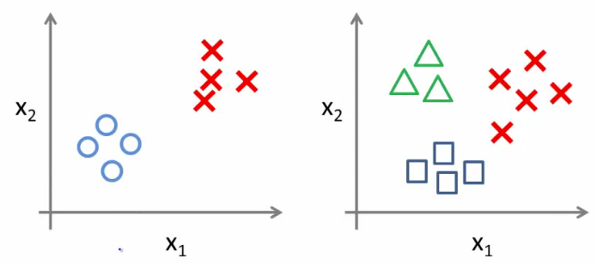
Classification analysis
Identifying to which of a set of class a new observation belongs, on the basis of a training set of data containing observations whose class is known
An algorithm that implements classification is known as a classifier
There are many classifiers:
classification trees, logistic regression, discriminant analysis, neural networks, boosted trees, random forests, deep learning methods, nearest neighbors, support vector machines, etc
By Madhu Sanjeevi, https://medium.com/deep-math-machine-learning-ai/chapter-2-0-logistic-regression-with-math-e9cbb3ec6077

Slide 5
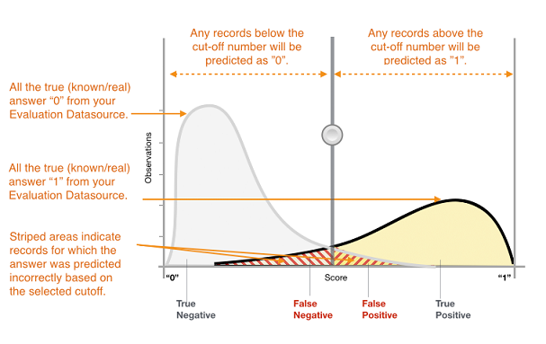
Binary classification
Binary or binomial classification is the task of classifying observations into two classes
In many practical binary classification problems, the two classes are not symmetric
Source: Amazon, https://docs.aws.amazon.com/machine-learning/latest/dg/binary-classification.html

Slide 6
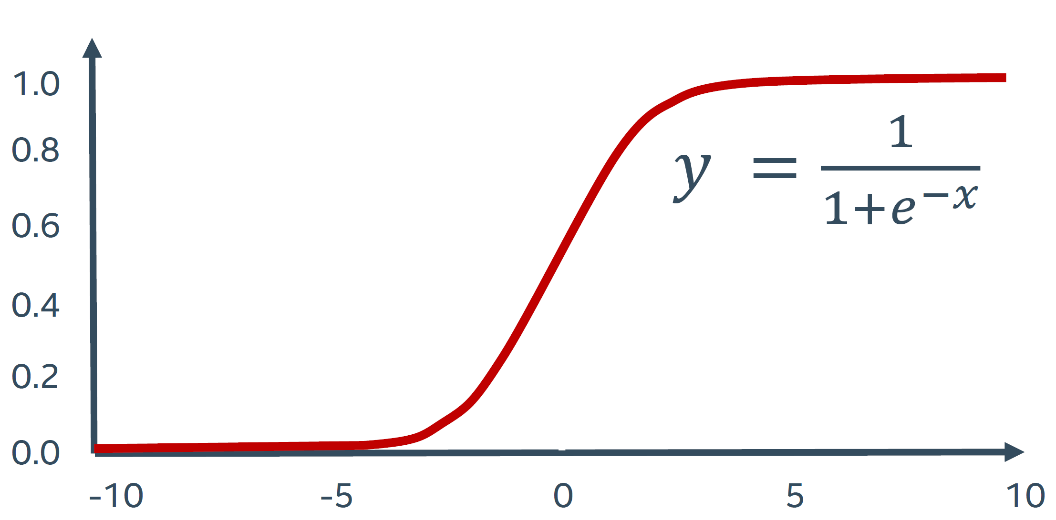
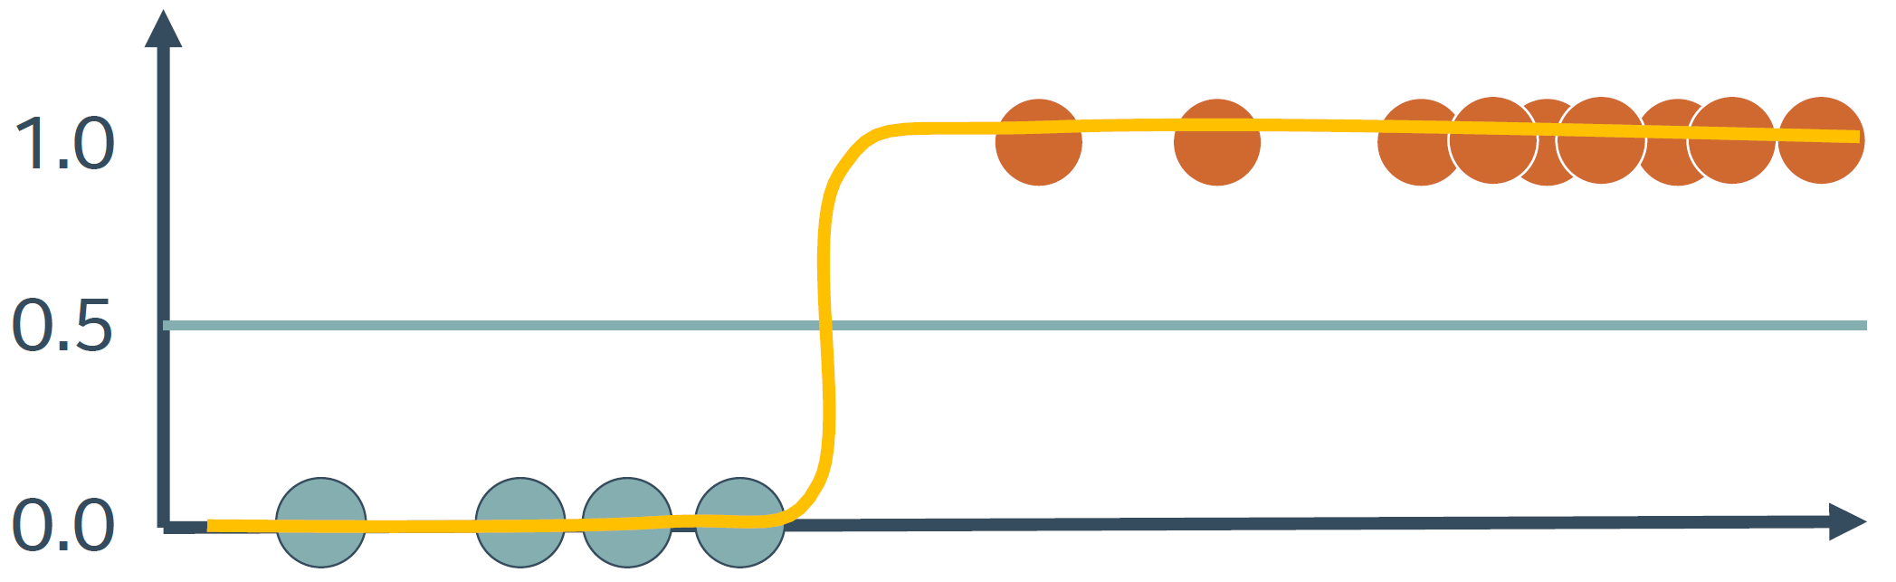
Logistic regression
In linear regression we tried to predict the output value using a linear function
In logistic regression we use a different hypothesis class to try to predict the probability that a given example belongs to the specific class
We need a S-shaped function that squashes values into the range [0,1] so that we may interpret them as a probability
Sigmoid function returns probability distribution
If the probability is under a threshold, observation will be classified as class 0

Slide 7
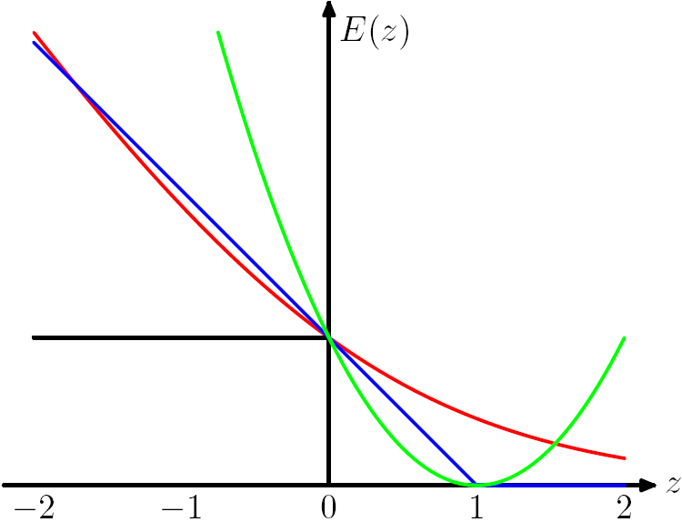
Loss functions for classification
The task is to find a function that minimizes the difference between predicted and actual values
Square loss (L2-norm loss)
sum of the square of the differences between the target value and the estimated values
Cross entropy loss
Measures the performance of a classification model whose output is a probability value between 0 and 1
Increases as the predicted probability diverges from the actual label
The Hinge Loss E(z) = max(0,1-z) is plotted in blue, the Log Loss in red, the Square Loss in green and the 0/1 error in black
Source: Microsoft, https://research.microsoft.com/en-us/um/people/manik/projects/trade-off/hinge.html

Slide 8
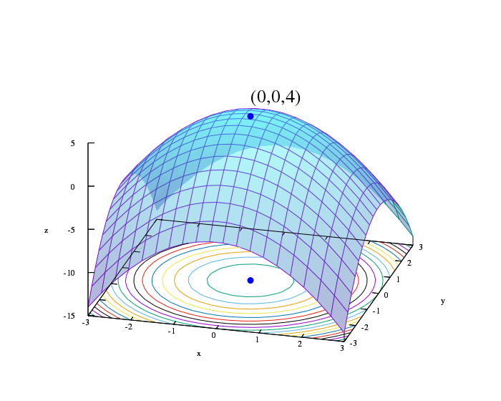
Binary classification using BFGS
Broyden–Fletcher–Goldfarb–Shanno (BFGS) algorithm use quasi-Newtonian methods to estimate the computationally intensive Hessian matrix
In quasi-Newton methods, the Hessian matrix of second derivatives is not computed
Instead, the Hessian matrix is approximated using updates specified by gradient evaluations
By IkamusumeFan - Own work, CC BY-SA 4.0, https://commons.wikimedia.org/w/index.php?curid=42043175

Slide 9
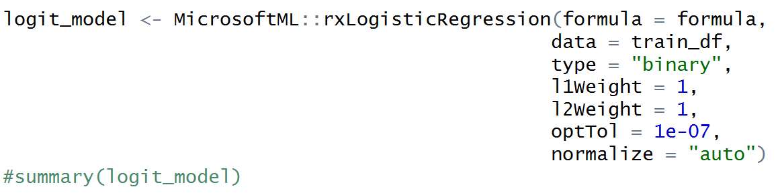
rxLogisticRegression: classification with L-BFGS
Can use elastic net regularization: a linear combination of L1 and L2 regularizations
Adding the ridge penalty to the regularization can improve model accuracy when the number of predictors is greater than the sample size
memorySize parameter specifies the number of past positions and gradients to store for use in the computation of the next step

Slide 10
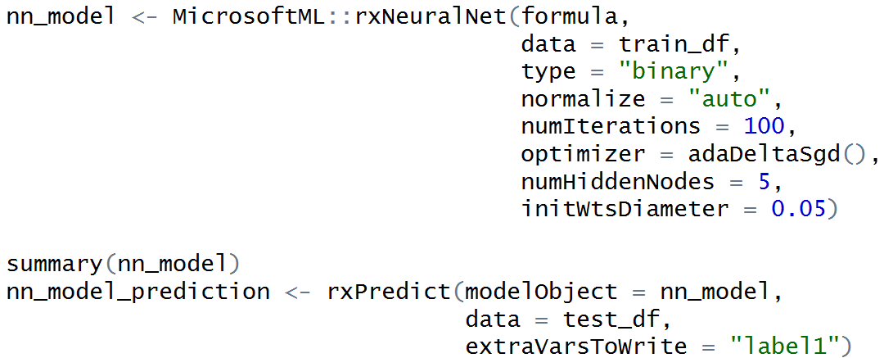
rxNeuralNet: binary classification with neural nets
Neural network for classification or regression is especially suited to problems where a more traditional model cannot fit a solution

Slide 11
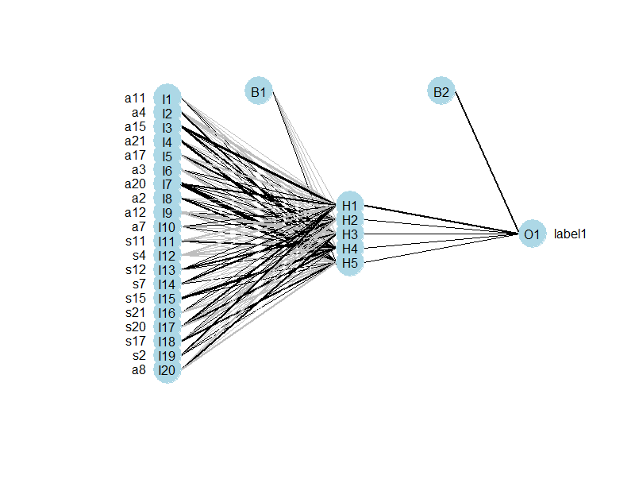
rxNeuralNet: binary classification with neural nets

Slide 12
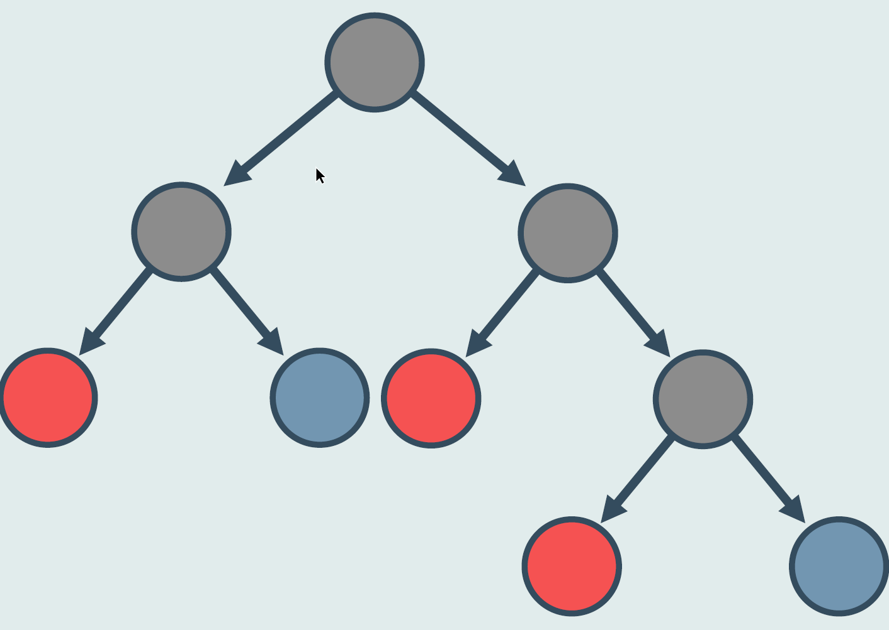
Decision trees
A decision tree is a tree in which each branch node represents a choice between a number of alternatives, and each leaf node represents a classification or decision

Slide 13
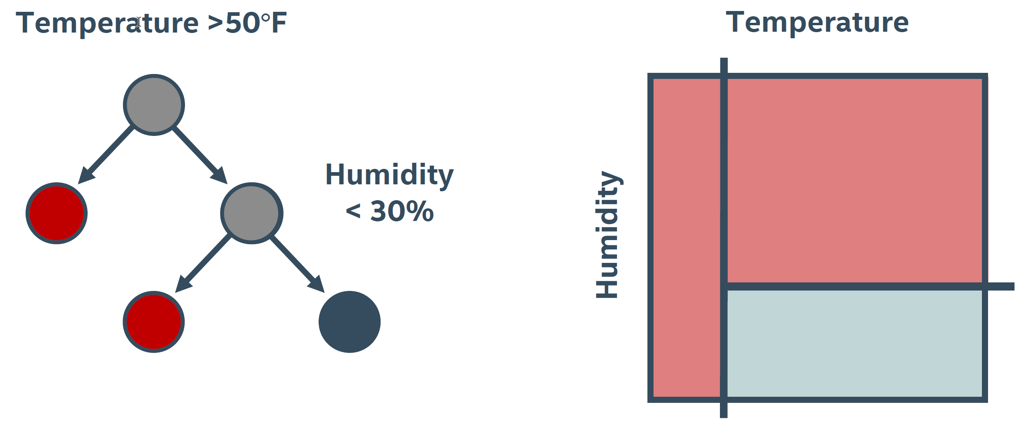
Classification by induction of decision trees
The algorithm operates over a set of training instances, C
If all instances in C are in class P, create a node P and stop, otherwise select a feature or attribute F and create a decision node
Partition the training instances in C into subsets according to the values of V
Apply the algorithm recursively to each of the subsets C

Slide 14
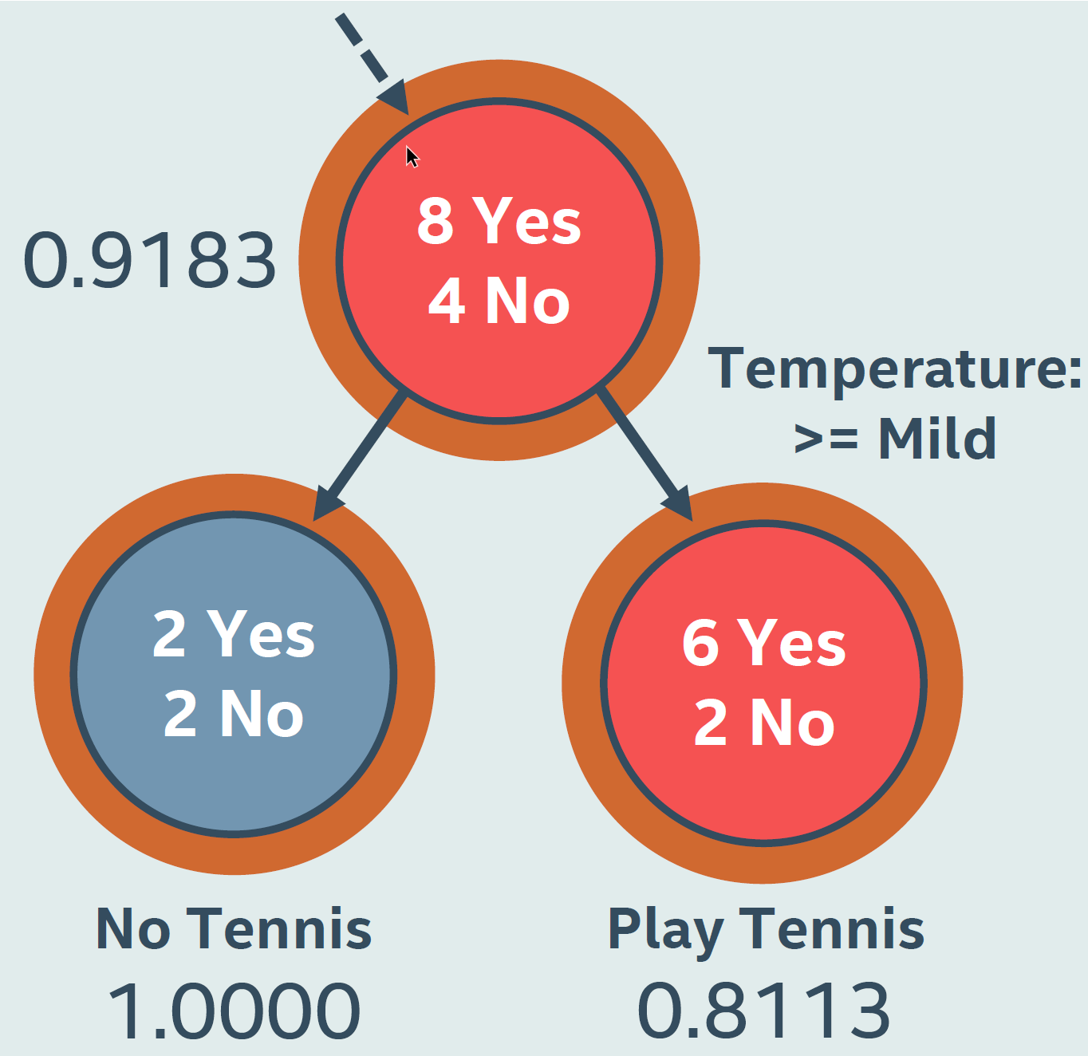
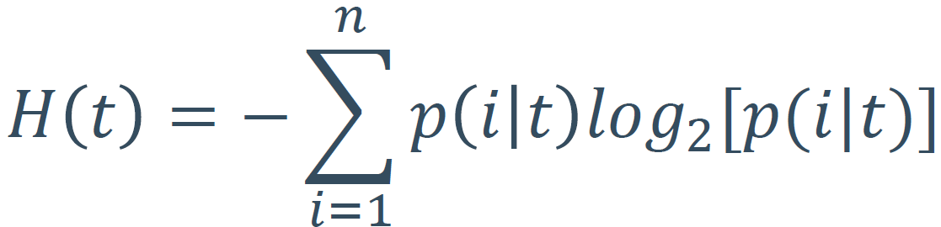
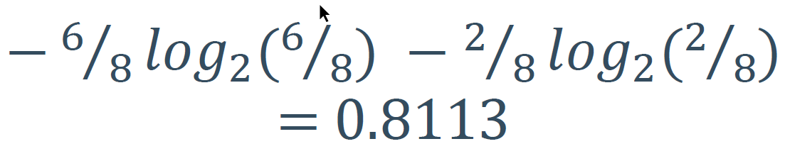
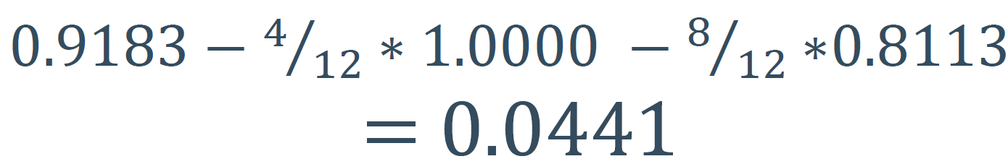
Using entropy to split
Entropy
Right leaf entropy
Left branch entropy

Slide 15
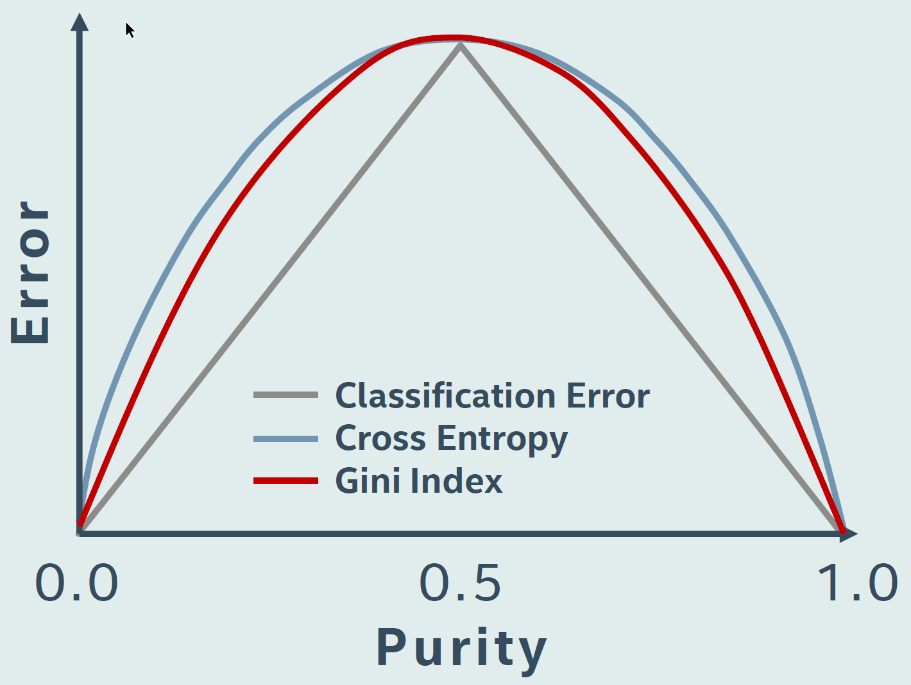
Entropy and Gini index
Center represents random guessing (50/50)
The partition method should move us from the center
Entropy has a maximum at the center
The Gini index measures the inequality among values of a frequency distribution and looks similar to entropy

Slide 16
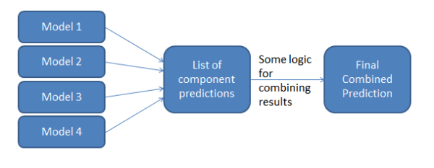
Ensemble models
Ensemble models provide better coverage and accuracy than single decision trees
Ensemble model can be build by:
Selecting training data - additional training data used by particular classifiers are created by bootstrapping
Selecting variables - training data of individual classifiers contain only selected variables
Using multiple learning algorithms

Slide 17
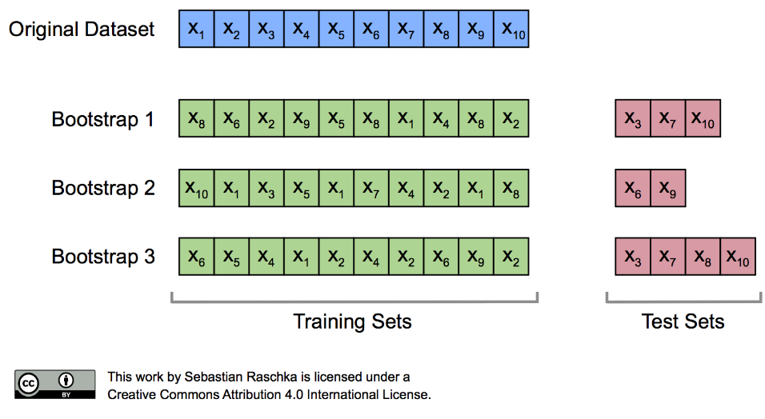
Bootstrapping
Process that is supposed to proceed without external help
Bootstrapping is any test that relies on random sampling with replacement
Practice of estimating properties of an model (such as its precision) by measuring those properties when sampling from an approximating distribution

Slide 18
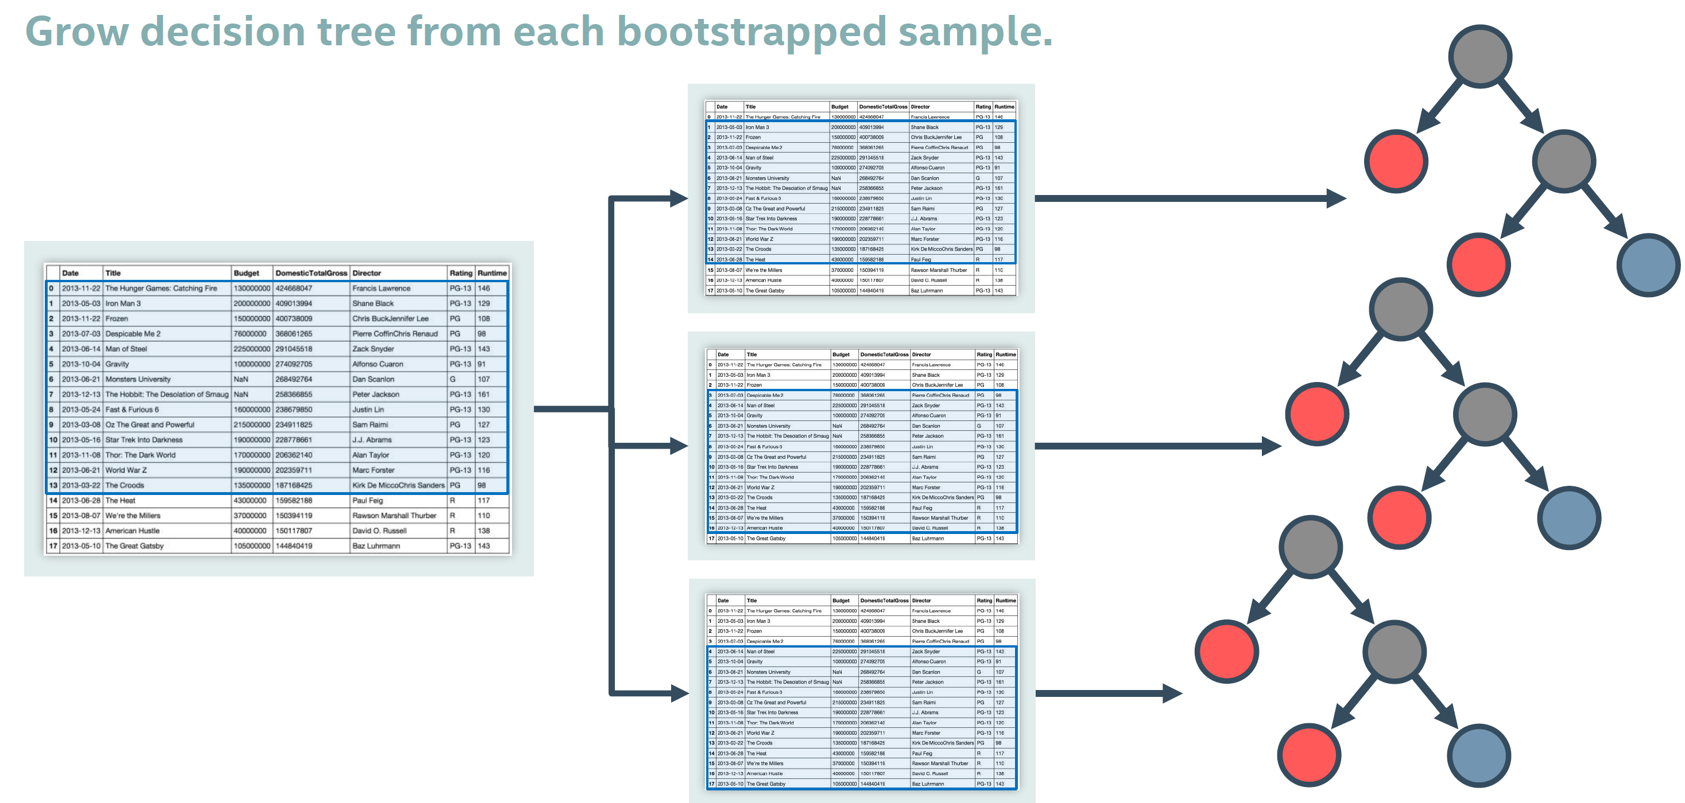
Random forest

Slide 19
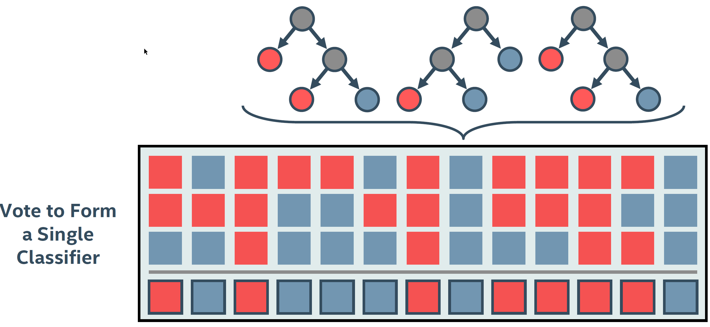
Final prediction

Slide 20
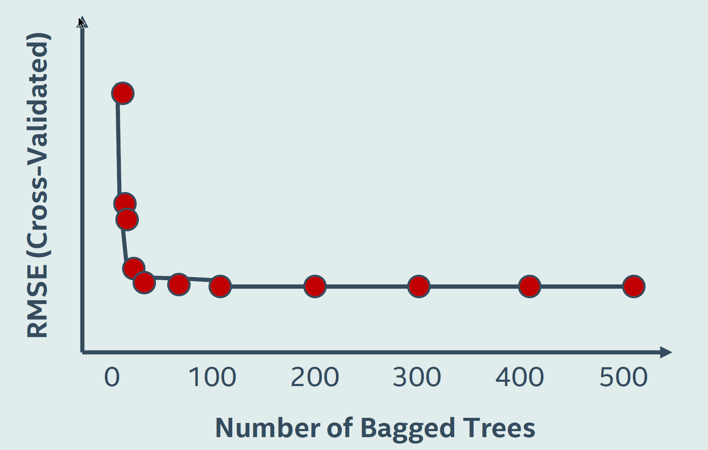
How many trees we need?

Slide 21
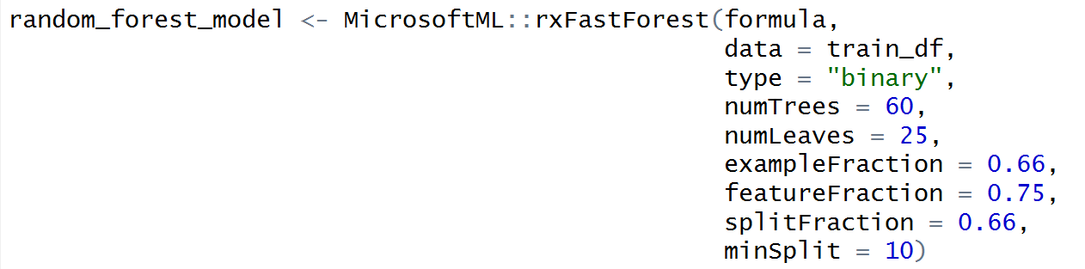
rxFastForest: binary classification with random forest
This decision forest classifier consists of an ensemble of decision trees
exampleFraction is fraction of randomly chosen instances to use for each tree
featureFraction is fraction of randomly chosen features to use for each tree
splitFraction is fraction of randomly chosen features to use on each split

Slide 22
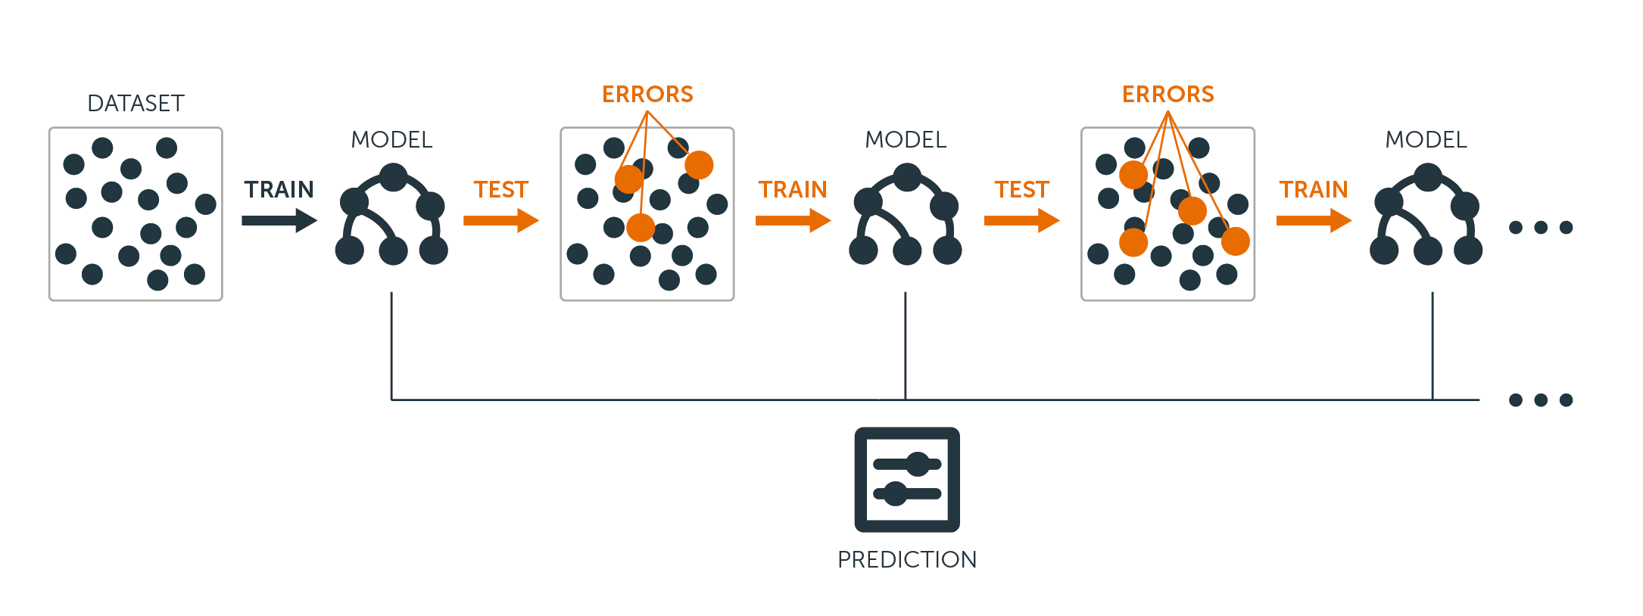
Boosted decision trees
Boosting means that each tree is dependent on prior trees
The algorithm learns by fitting the residual of the trees that preceded it
Thus, boosting in a decision tree ensemble tends to improve accuracy with some small risk of less coverage
By Joe Klein, https://medium.com/@jklein694/ensemble-methods-boosting-be4fd93fdc6f

Slide 23
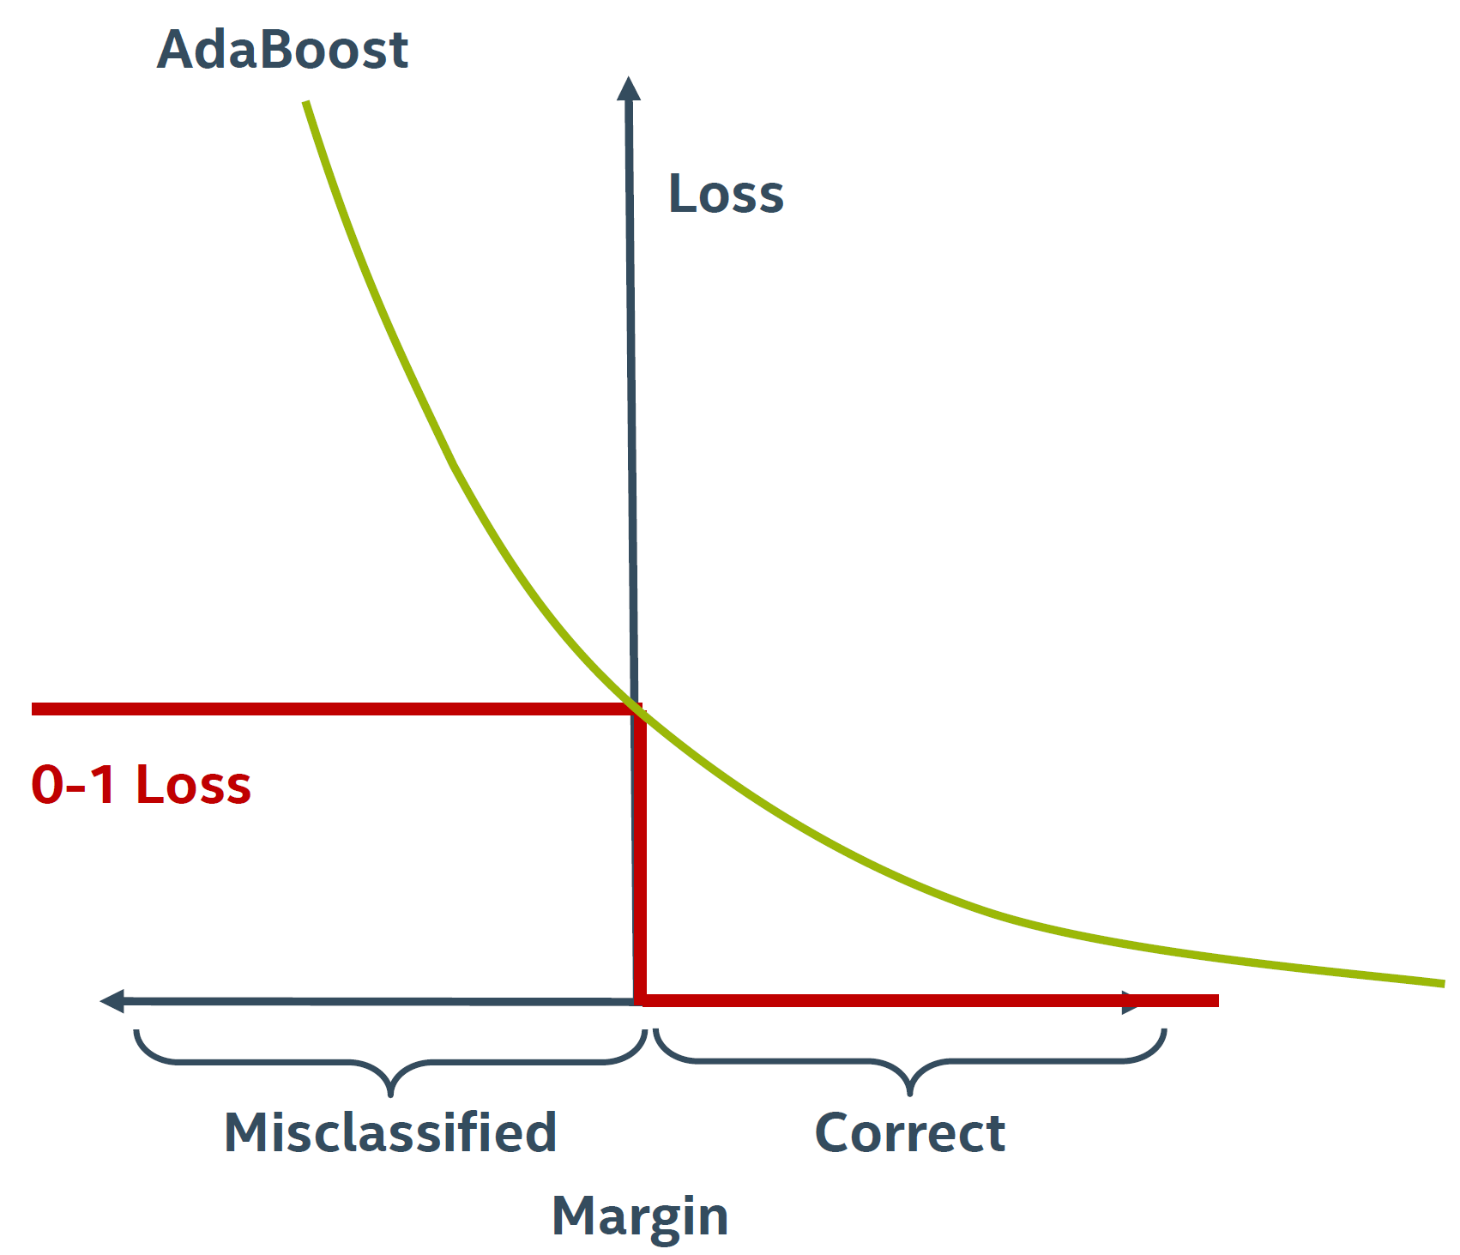
Loss functions for boosting
0-1 loss function multiplies misclassified observations by 1, and ignoring the correct ones
Difficult to optimize
AdaBoost, short for “Adaptive Boosting”, is the first practical boosting algorithm
AdaBoost uses the exponential loss function
More sensitive to outliers than other loss functions

Slide 24
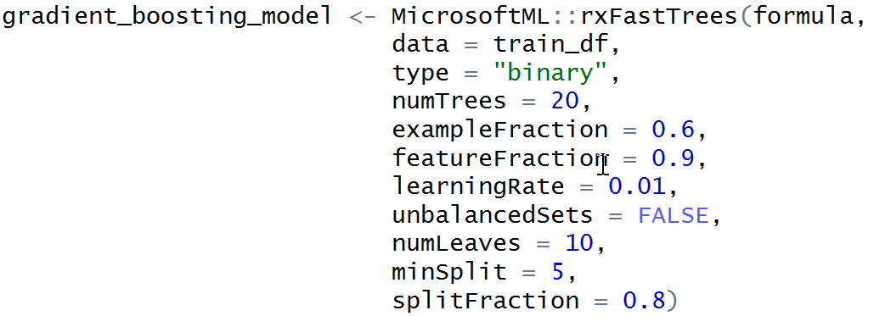
rxFastTrees: binary classification with boosted trees
rxFastTrees is an implementation of FastRank, which is an implementation of the MART
The ensemble of trees is produced by computing, in each step, a regression tree that approximates the gradient of the loss function, and adding it to the previous tree with coefficients that minimize the loss of the new tree
The output of the ensemble produced by MART on a given instance is the sum of the tree outputs, converted to a probability

Slide 25
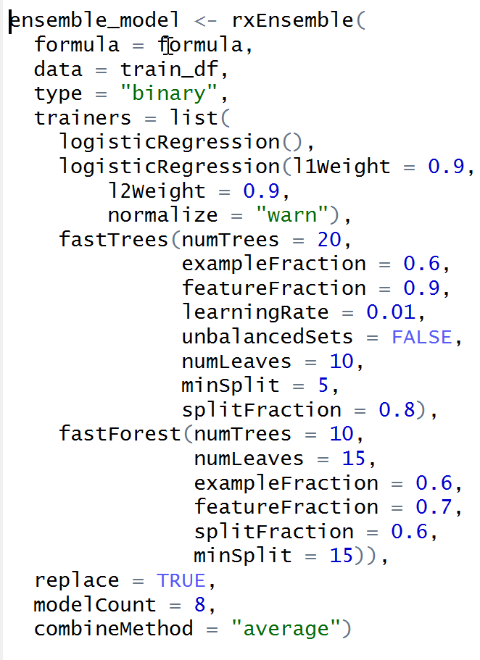
rxEnsemble: stacking models
Train an ensemble of models of various kinds to obtain better predictive performance than could be obtained from a single model
combineMethod specifies the method used to combine the models:
median to compute the median of the individual model outputs,
average to compute the average of the individual model outputs and
vote to compute (pos-neg) / the total number of models, where 'pos' is the number of positive outputs and 'neg' is the number of negative outputs

Slide 26
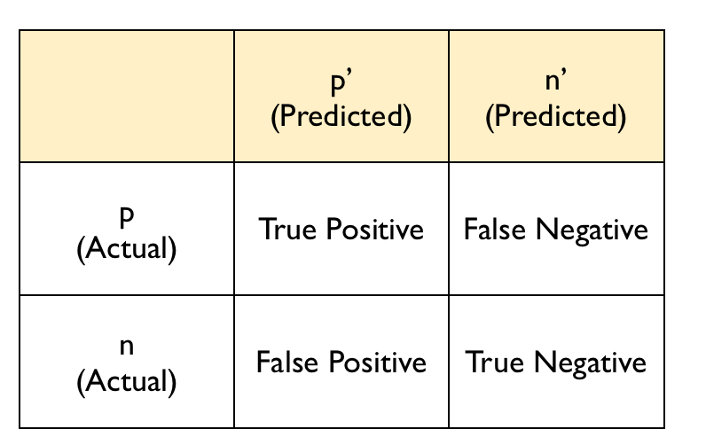
Evaluation metrics for binary classification models
In a binary classification scenario, the target variable has only two possible outcomes: {0, 1} or {false, true}
One outcome is called positive p, the second – negative n
Confusion matrix is one of the most intuitive metrics used for finding the correctness and accuracy of the model

Slide 27
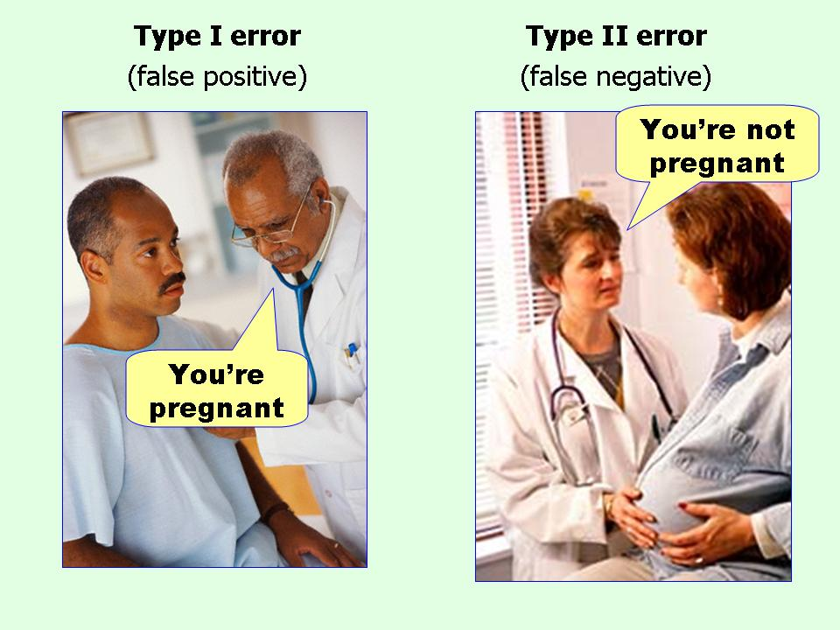
When to minimize what?
The ideal scenario that we all want is that the model should give 0 False Positives and 0 False Negatives
Minimizing False Negatives
In case of cancer classification missing a cancer patient will be a huge mistake
Minimizing False Positives
In case of spam email classification, minimizing False positives is more important than False Negatives
Source: Effect Size FAQs by Paul Ellis

Slide 28
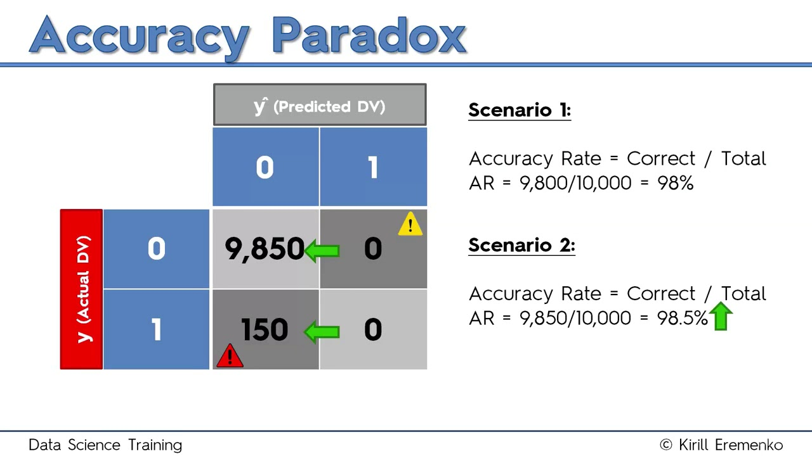
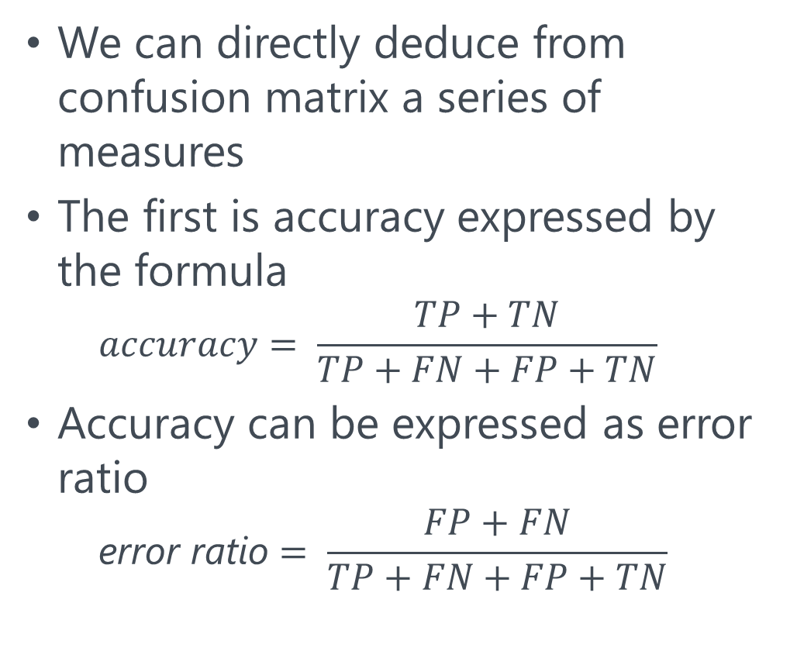
Accuracy paradox
We can directly deduce from confusion matrix a series of measures
The first is accuracy expressed by the formula
$$accuracy= \frac{TP+TN}{TP+FN+FP+TN}$$
Accuracy can be expressed as error ratio
$$\text{error} \text{ratio}= \frac{FP+FN}{TP+FN+FP+TN}$$
Model with zero predictive power may have high accuracy

Slide 29
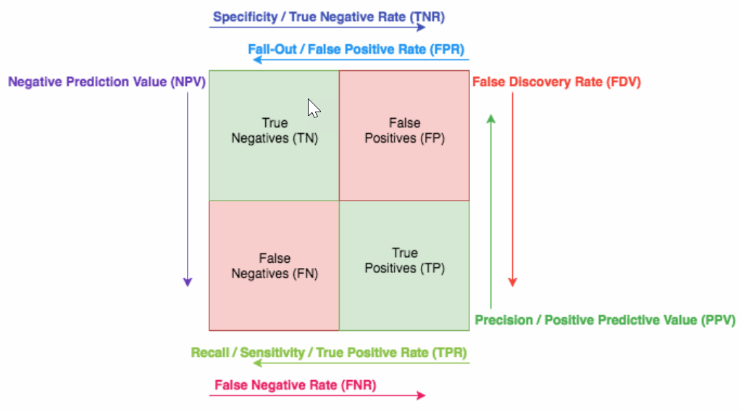
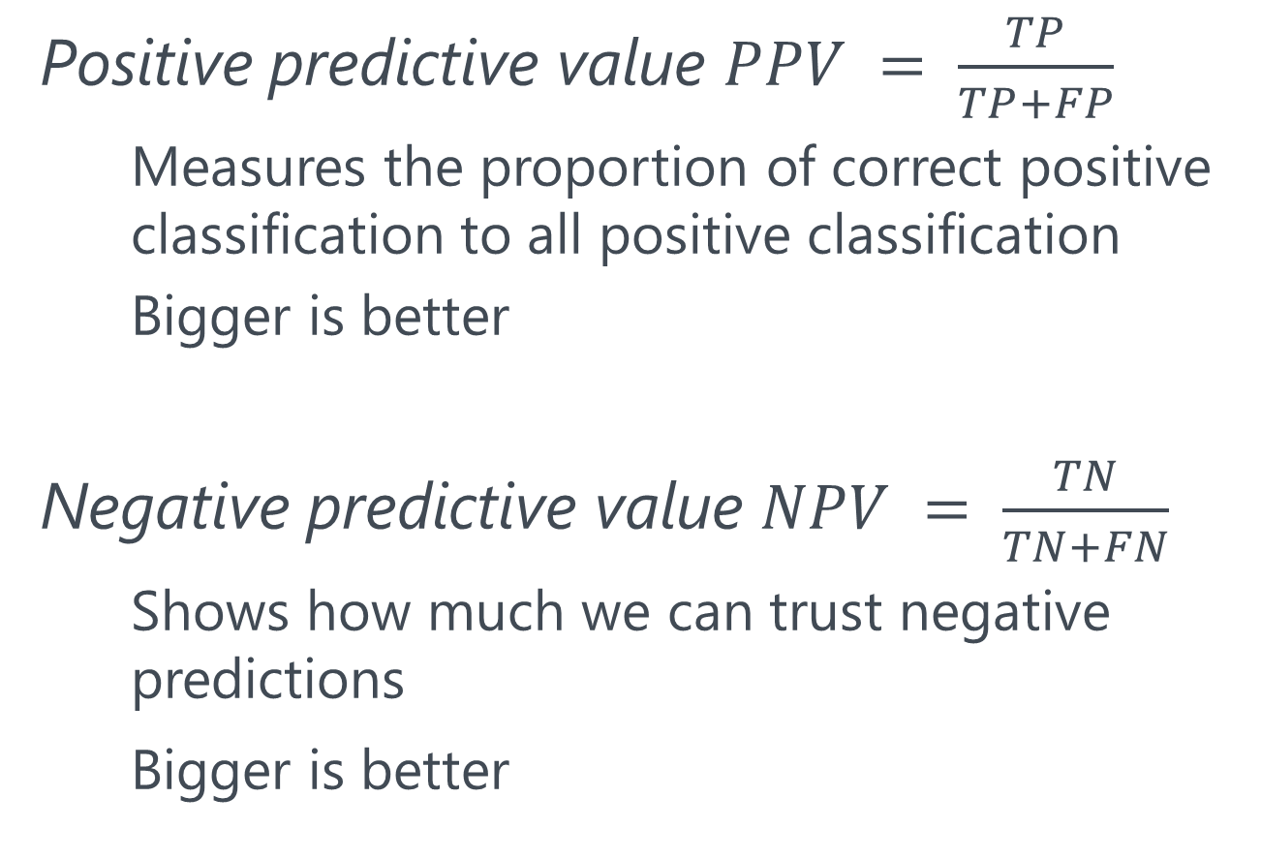
Beyond accuracy: Precision metrics
Positive predictive value $PPV = \frac{TP}{TP+FP}$
Measures the proportion of correct positive classification to all positive classification
Bigger is better
Negative predictive value $NPV = \frac{TN}{TN+FN}$
Shows how much we can trust negative predictions
Bigger is better
By Sanyam Kapoor, https://www.sanyamkapoor.com/machine-learning/confusion-matrix-visualization/

Slide 30
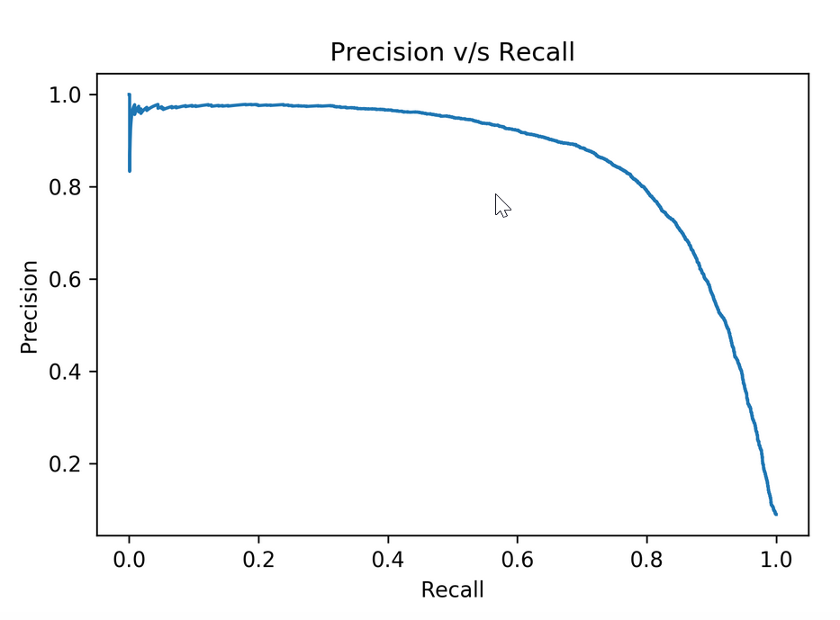
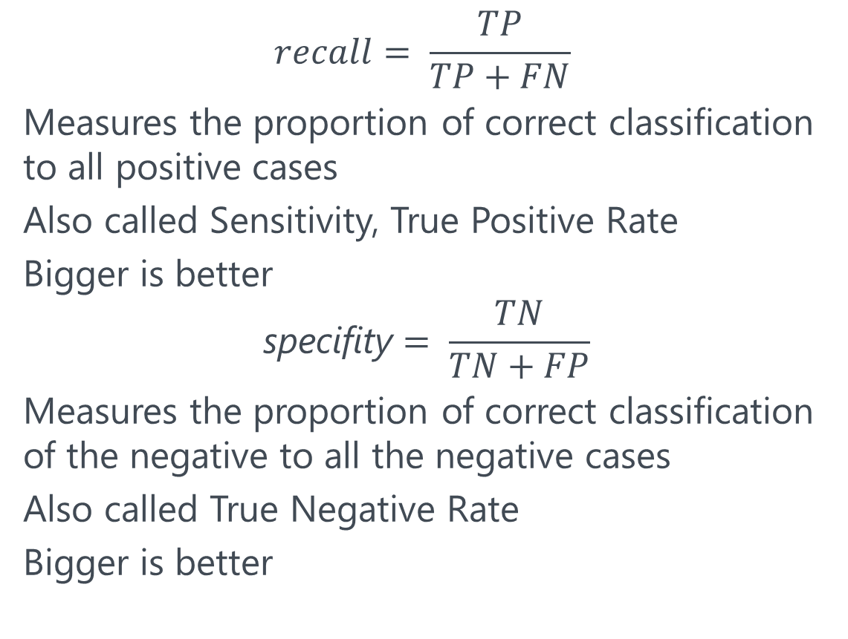
Beyond accuracy: range metrics
$$recall= \frac{TP}{TP+FN}$$
Measures the proportion of correct classification to all positive cases
Also called Sensitivity, True Positive Rate
Bigger is better
$$\text{specifity}= \frac{TN}{TN+FP}$$
Measures the proportion of correct classification of the negative to all the negative cases
Also called True Negative Rate
Bigger is better
If we want to focus more on minimising False Negatives, we would want our Recall to be as close to 100% as possible without precision being too bad
If we want to focus on minimising False positives, then our focus should be to make Precision as close to 100% as possible

Slide 31
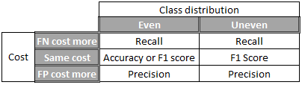
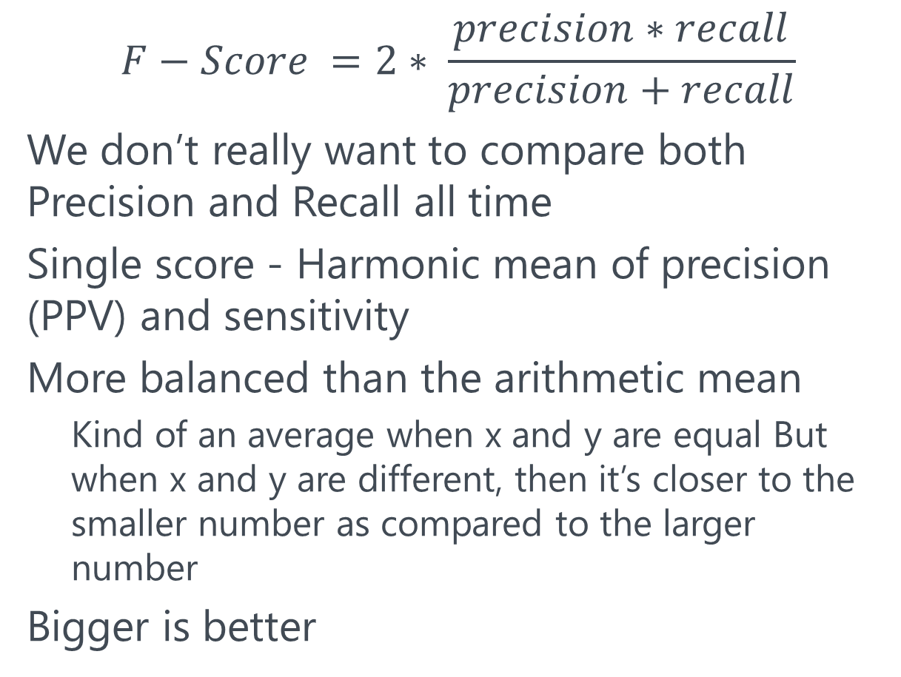
Precision and Recall: F-Score
$$F−Score =2∗ \frac{precision∗recall}{precision+recall}$$
We don’t really want to compare both Precision and Recall all time
Single score - Harmonic mean of precision (PPV) and sensitivity
More balanced than the arithmetic mean
Kind of an average when x and y are equal But when x and y are different, then it’s closer to the smaller number as compared to the larger number
Bigger is better
By Andreas de Ruiter (Microsoft), https://blogs.msdn.microsoft.com/andreasderuiter/2015/02/09/performance-measures-in-azure-ml-accuracy-precision-recall-and-f1-score/

Slide 32
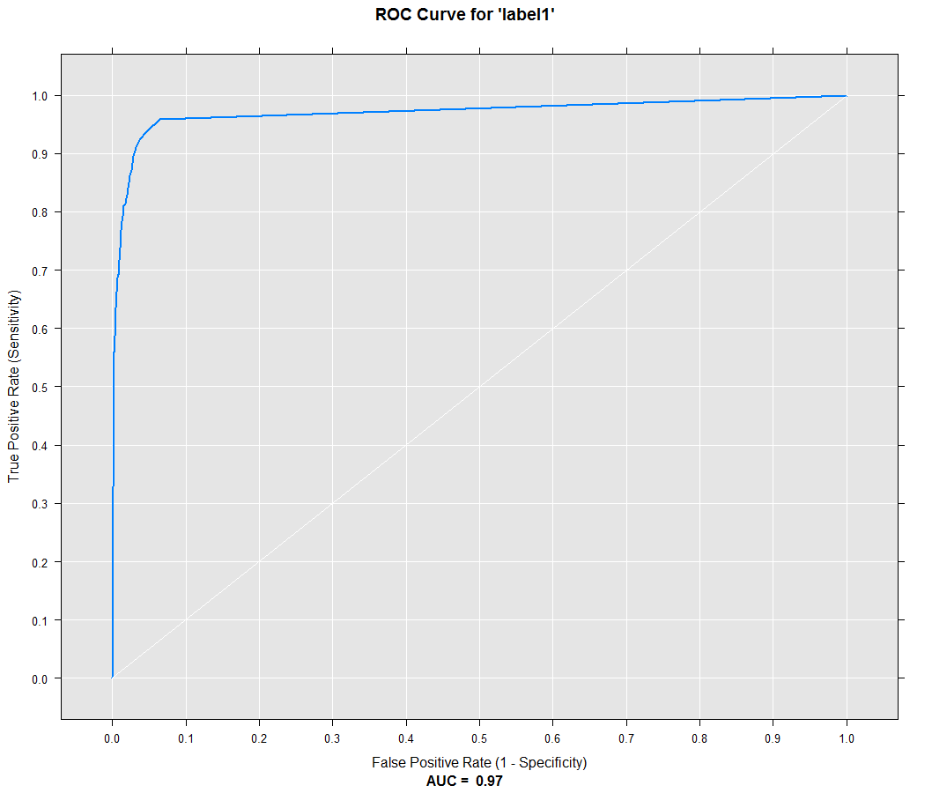
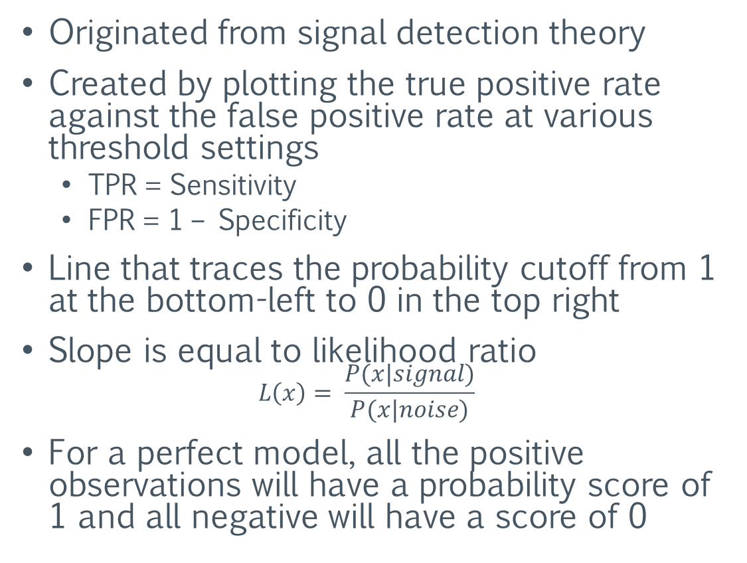
Sensitivity and Specificity: Receiver Operating Characteristics Curve (ROC)
Originated from signal detection theory
Created by plotting the true positive rate against the false positive rate at various threshold settings
TPR = Sensitivity
FPR = 1 – Specificity
Line that traces the probability cutoff from 1 at the bottom-left to 0 in the top right
Slope is equal to likelihood ratio $L\left(x\right)= \frac{P(x|signal)}{P(x|noise)}$
For a perfect model, all the positive observations will have a probability score of 1 and all negative will have a score of 0

Slide 33
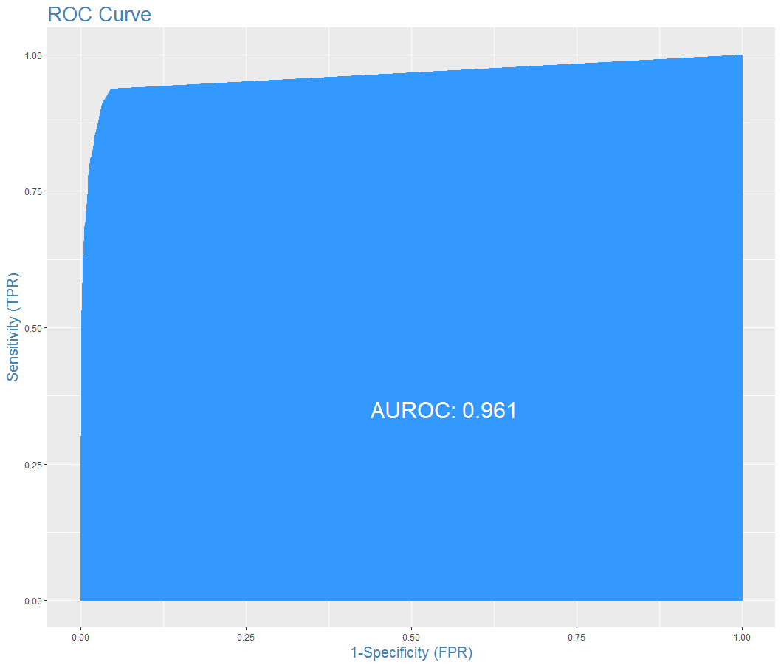
Confidence: Area under the curve
A random classifier has an area under the curve of 0.5, while AUC for a perfect classifier is equal to 1
AUC of 0.8 means that a randomly selected positive observation has a score larger than that for a randomly chosen negative observation in 80% of the time

Slide 34
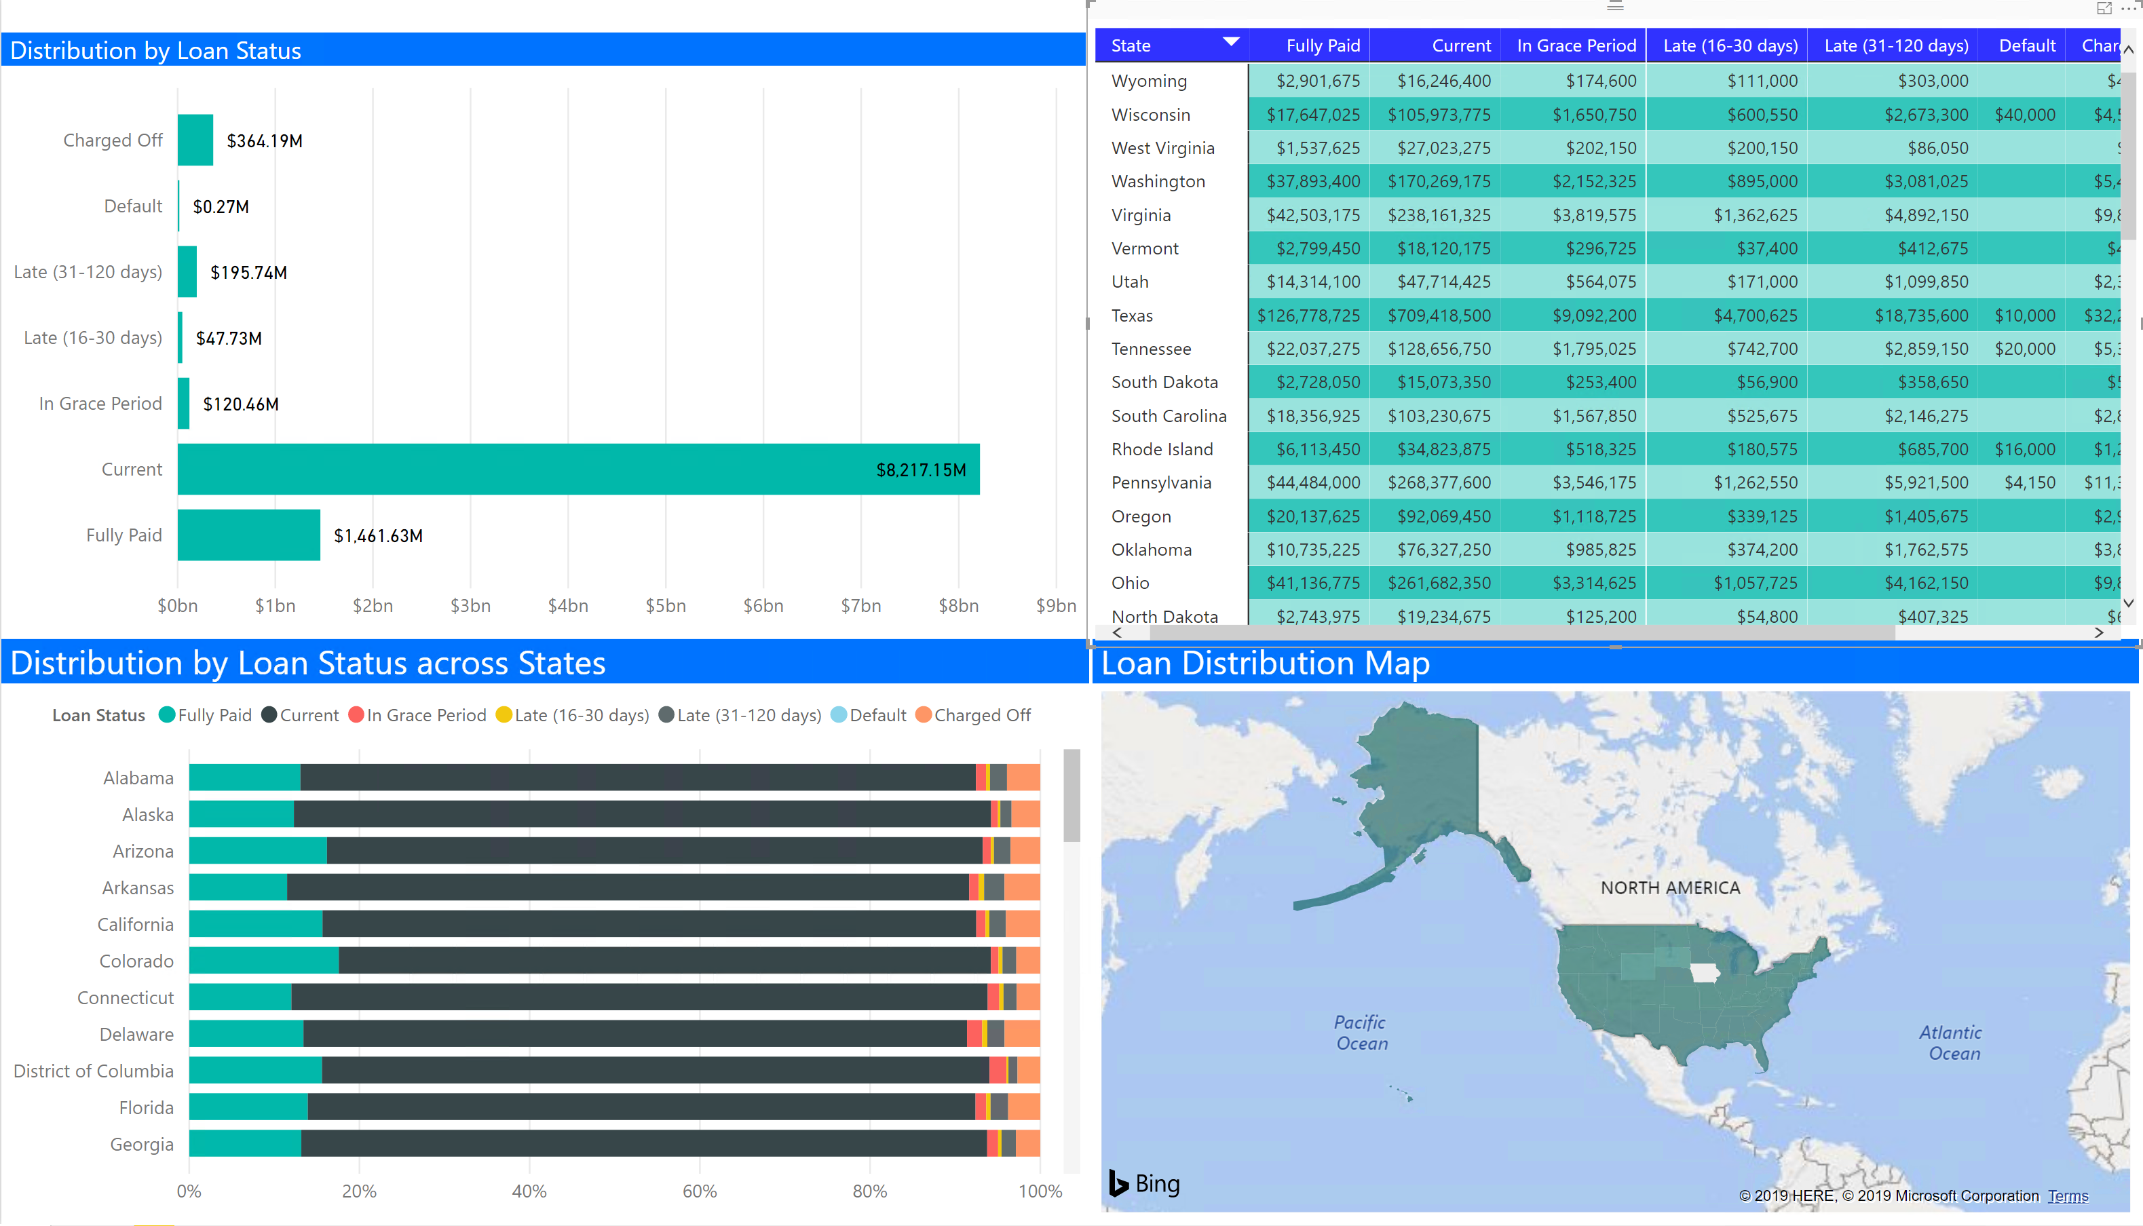
Binary classification: credit risk analysis
If we had a crystal ball, we would only loan money to someone we knew would pay us back
A lending institution can make use of predictive analytics to reduce number of loans they offer to those borrowers most likely to default, increasing the profitablity of their loan portfolio

Slide 35
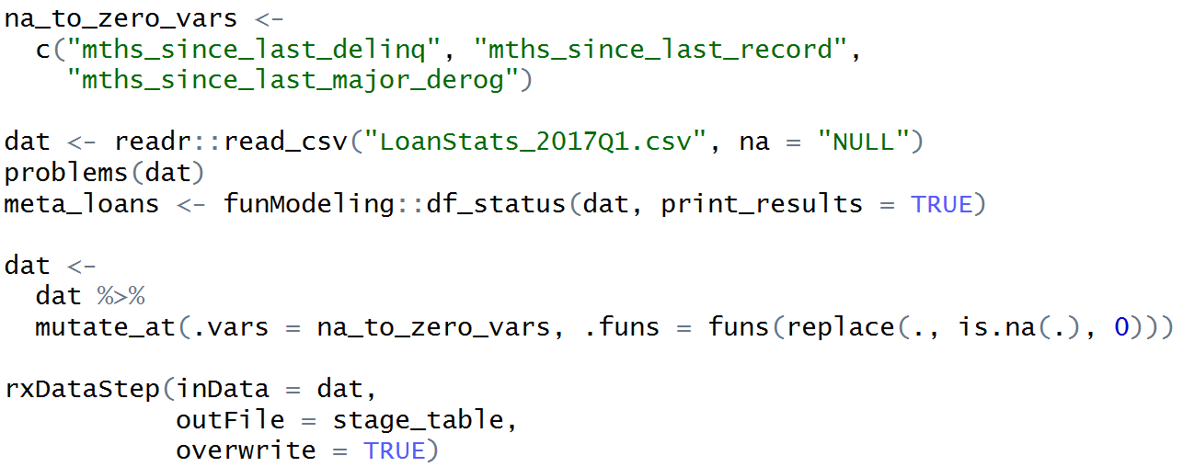
Data import
Data is taken from Lending Club Statistics Page

Slide 36
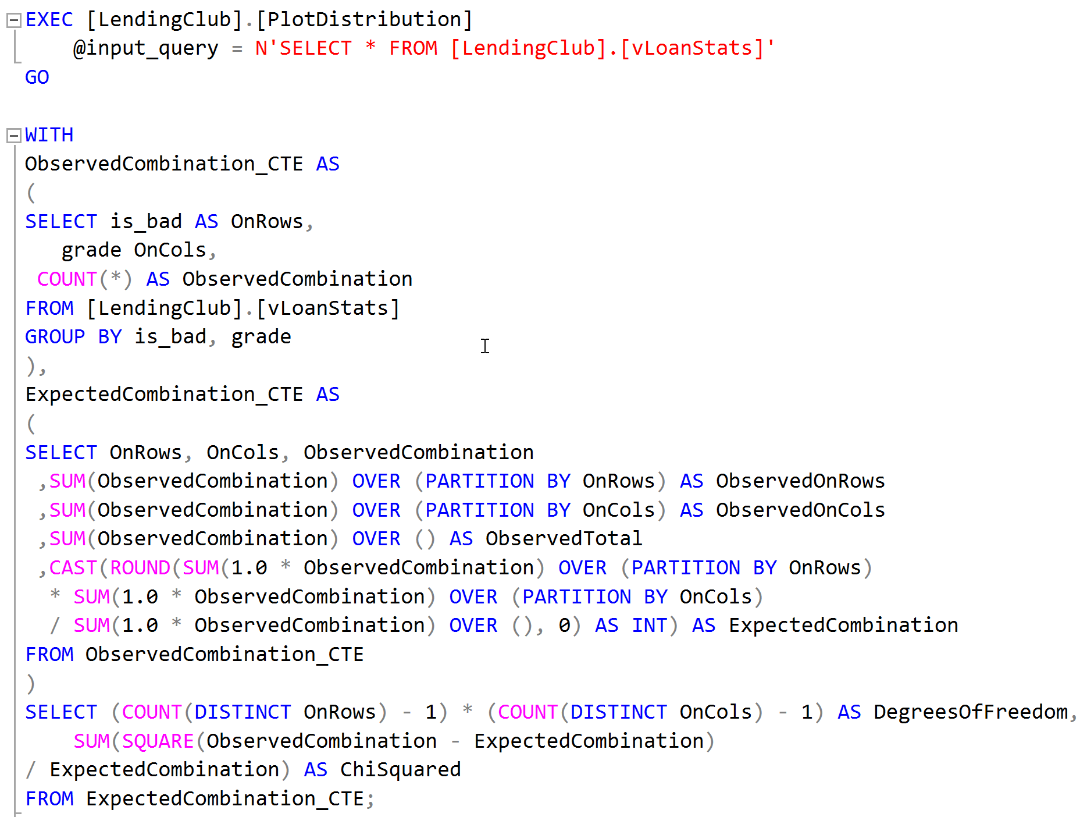
Data evaluation

Slide 37
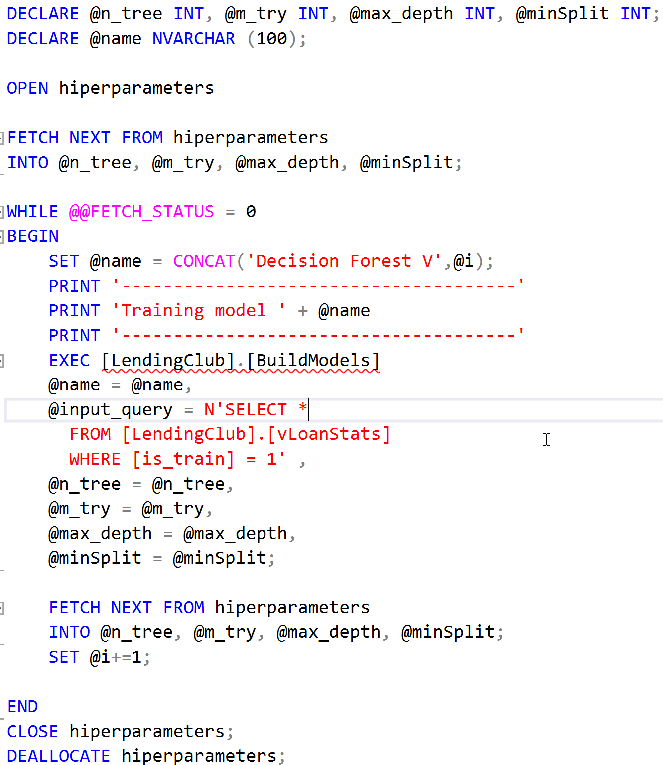
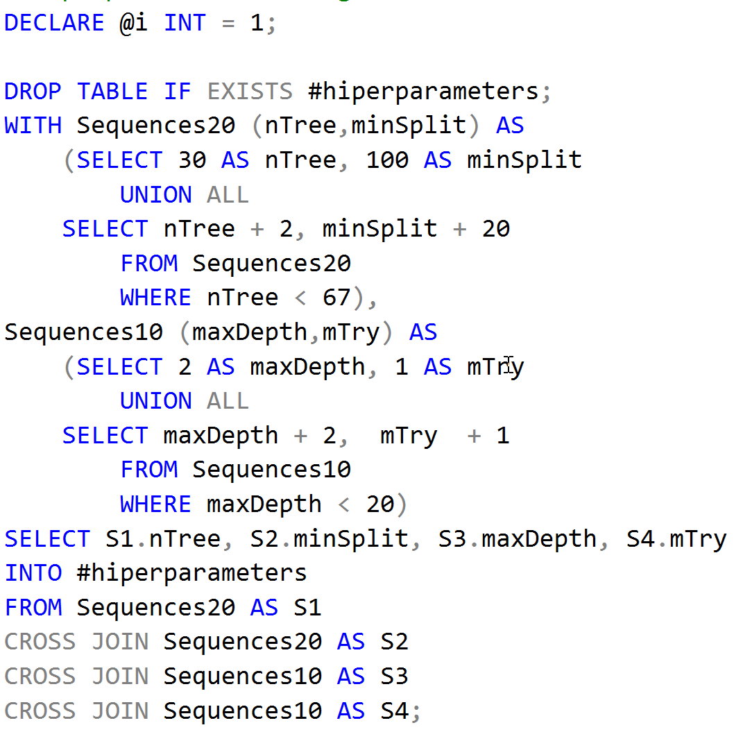
Modelling with hyperparameters tuning

Slide 38
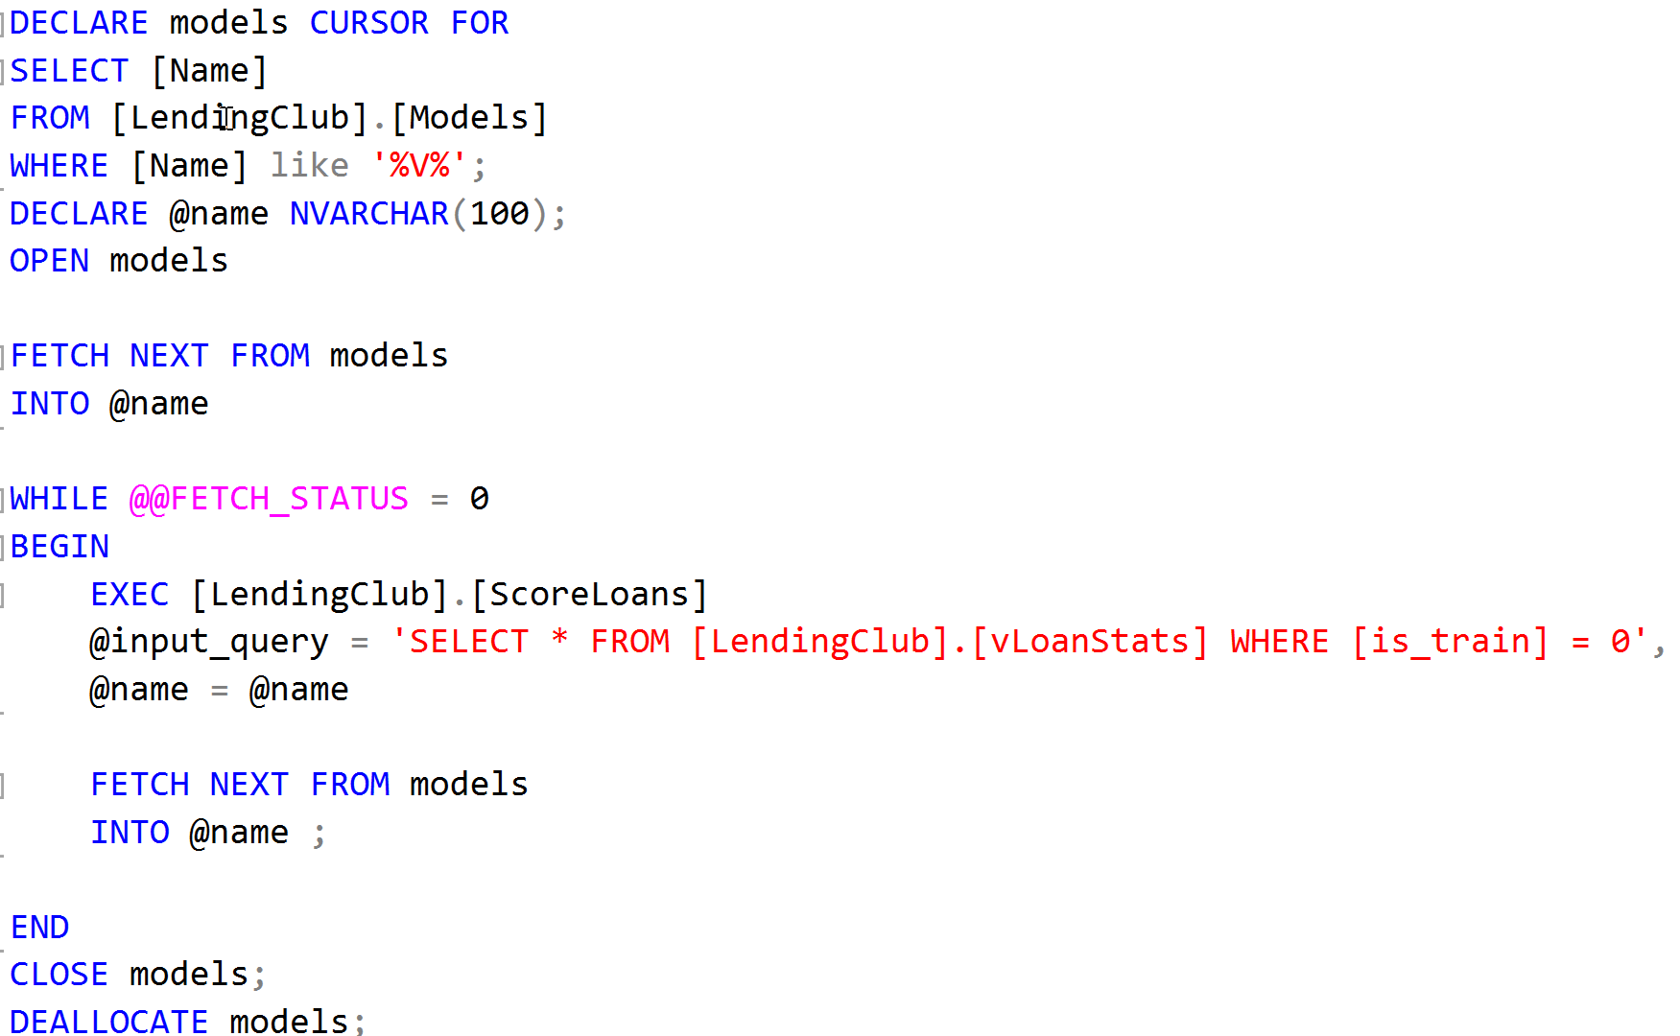
Model evaluation

Slide 39
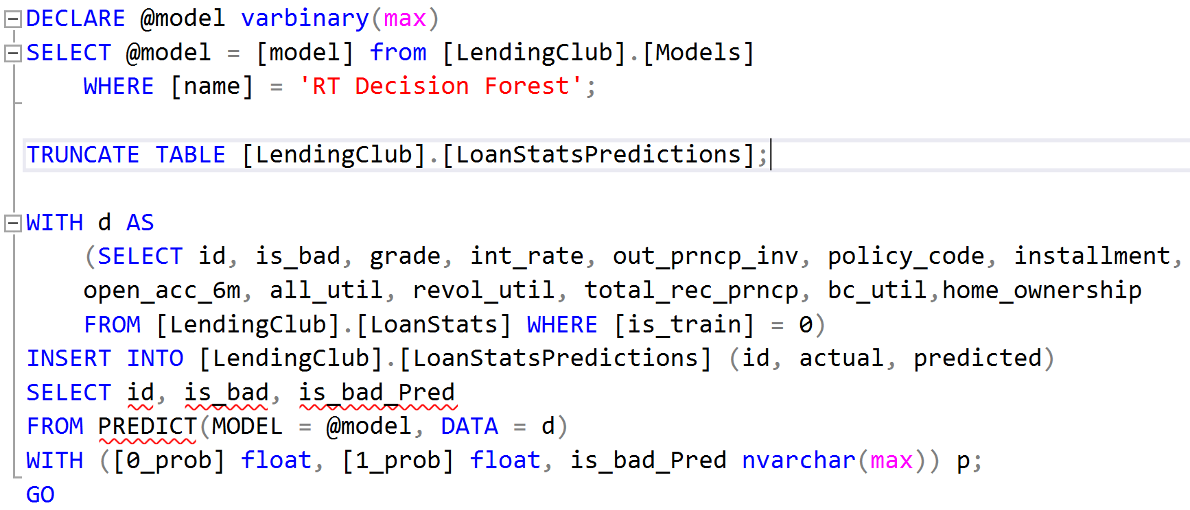
Model deployment

Slide 40
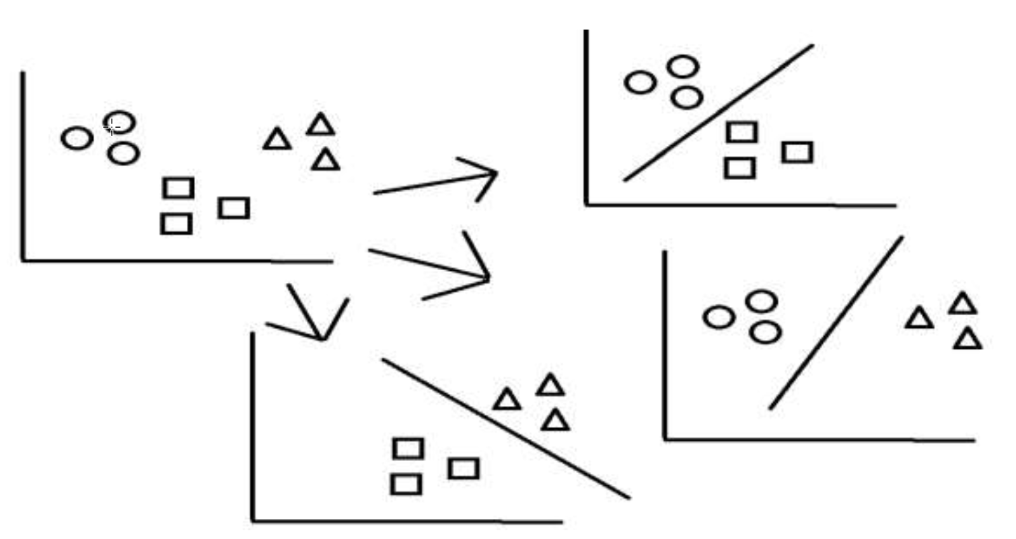
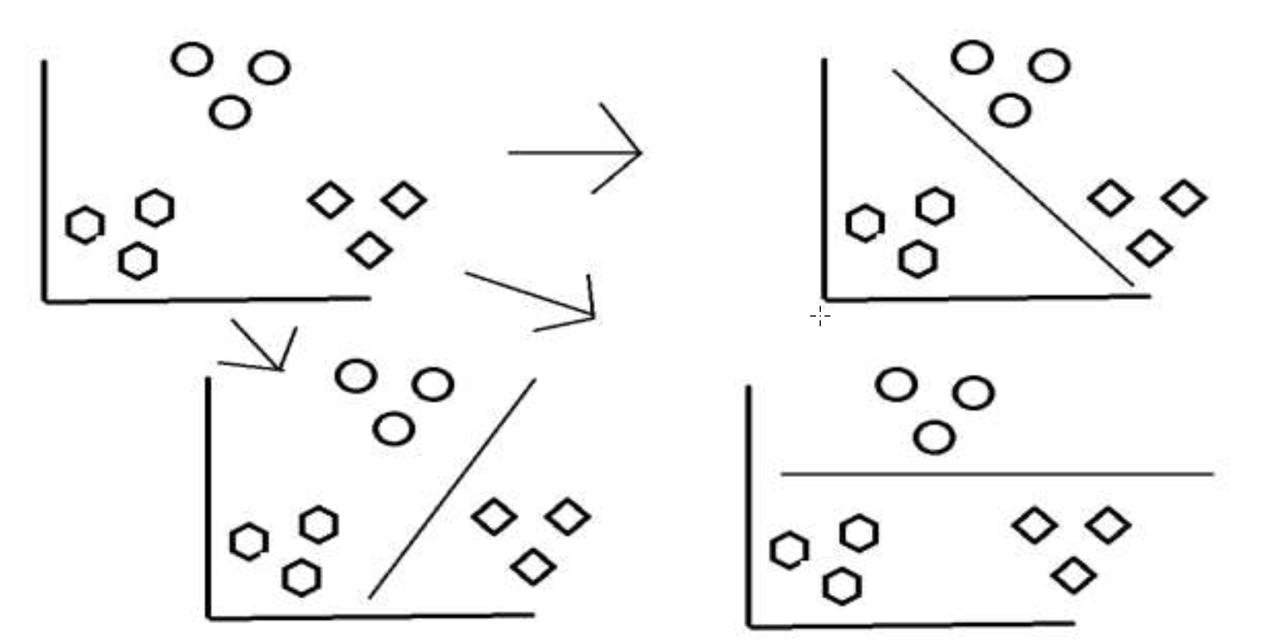
Multiclass classification
Classifying observations into one of three or more classes
Inputs can be classified as one of many outputs
We can divide multi-class classification into easier binary classification problems
One-vs-One (OVO) divide the data sets into pairs and then do classification
One-vs-All (OVA) divide the data sets such that a hypothesis separates one class label from all of the rest

Slide 41
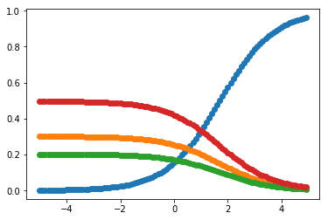
Softmax function
Normalized exponential function
Generalization of the logistic function that squashes a vector of arbitrary real values to vector of real values in the range (0, 1) and all the entries add up to 1
Calculate the probabilities of each target class over all possible target classes

Slide 42
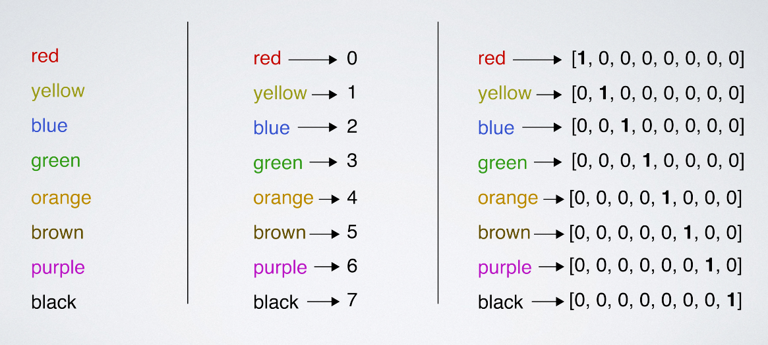
One-hot encoding
The output is a list of probabilities with which the observations belong to different classes
We can convert label into the same thing
One-hot encoding turns numbers into labels, probability of each class is 0, except for the correct class, which is 1
By Andrew Glassner, The Imaginary Institute

Slide 43
Sigmoid and Softmax
Sigmoid function
Used for binary classification
The probabilities sum need not be 1
Softmax Function
Used for multiclass classification
The probabilities sum will be 1
exp/(1+exp)
exp/sum(exp)
class | output | exp | sigmoid | softmax | label
A | -4.640 | 0.010 | 0.010 | 0.000 | 0
B | -2.680 | 0.069 | 0.064 | 0.003 | 0
C | 2.870 | 17.637 | 0.946 | 0.850 | 1
D | -2.080 | 0.125 | 0.111 | 0.006 | 0
E | 1.030 | 2.801 | 0.737 | 0.135 | 0
F | -2.260 | 0.104 | 0.094 | 0.005 | 0
Sum | -7.76 | 20.745 | 1.962 | 1

Slide 44

rxLogisticRegression: multiclass classification using L-BFGS
Memory size for L-BFGS, specifying the number of past positions and gradients to store for the computation of the next step
This optimization parameter limits the amount of memory that is used to compute the magnitude and direction of the next step
When you specify less memory, training is faster but less accurate

Slide 45

rxNeuralNet: multiclass classification using neural net
This algorithm is single-threaded and will not attempt to load the entire dataset into memory

Slide 46

rxDForest: parallel external memory decision forest algorithm for classification and regression
Modeled after the randomForest package of Andy Liaw and Matthew Weiner
https://datajobs.com/data-science-repo/Random-Forest-[Liaw-and-Weiner].pdf

Slide 47

rxBTrees: parallel external memory algorithm for stochastic gradient boosted decision trees
Modeled after the gbm package of Greg Ridgeway
https://www.saedsayad.com/docs/gbm2.pdf

Slide 48


Evaluation metrics for multiclass classification models
We can build a confusion matrix by counting how many times a certain pair occurs between predicted and actual values
And generalize all the binary performance metrics such as precision, recall, and F1-score etc. to multi-class settings
By Gabriele Lanaro, https://gabrielelanaro.github.io/blog/2016/02/03/multiclass-evaluation-measures.html

Slide 49

Evaluation metrics for multiclass classification models
Source: Marina Sokolovaa, GuyLapalme, https://www.sciencedirect.com/science/article/pii/S0306457309000259

Slide 50

Evaluation metrics for multiclass classification models
You can either go with the micro-average or the macro-average
In micro-average method, you sum up the individual true positives, false positives, and false negatives of the system for different sets and then apply them to get the statistics
In macro-average, you take the average of the precision and recall of the system on different sets
Micro-average is preferable if there is a class imbalance problem

Slide 51

Train, evaluate and score multiclass classification models
Tasks:
Train models on diffrent data sets - model_factory
Evaluate models and write metrics to SQL
Operationalize training - [PredictiveMaintenance].[TrainMulticlassClassificationModel]

Slide 52
Evaluation and optimization

Slide 53

Bias-variance tradeoff
Error rate on the training set is bias
The difference between the test training error is variance
We can reduce error from bias but might increase error from variance as a result, or vice versa
This trade-off between too simple (high bias) vs. too complex (high variance) affects all supervised learning algorithms

Slide 54
Addressing bias and variance
Different model architectures will have different amounts of bias/variance for the same data
If you have high avoidable bias:
Increase the size of your model
Modify input features based on insights from error analysis
Reduce or eliminate regularization
Modify model architecture
If you have high variance:
Add data to your training set
Add regularization
Decrease number of input features
Modify input features based on insights from error analysis
Decrease the model size

Slide 55

Detecting overfitting
If a model does much better on the training set than on the test set, then we’re likely overfitting
Cross-validation can help
Choose a single-number evaluation metric
Choose your validation and test data set to reflect data you expect to get in the future and want to do well on
Your dev and test sets should come from the same distribution

Slide 56

Preventing overfitting
Train with more data
Better features engineering, including removing irrelevant features
Try different algorithm or ensembling
Use regularization and other hyperparameters tuning, like early stopping
Try simpler model or more complex model with more data
By Andrew Ng: EDS, Machine Learning Yearning

Slide 57


Cross-validation
Method for creating validation sets on the fly
To evaluate model performance, we’ll train on folds 2 through 5, then test with fold 1, and so on
By Andrew Glassner, The Imaginary Institute
By Fabian Flöck - Own work, CC BY-SA 3.0, https://commons.wikimedia.org/w/index.php?curid=51562781

